Slide 1

Making Maps with R
Southcoast UseR! October 2021
Lucy McGinnis

Slide 2
Why make a map?
Excellent communication tool
A more intuitive way to visualize data
Can layer a lot of information into one visual. Overlay different ideas to show new findings

Slide 3
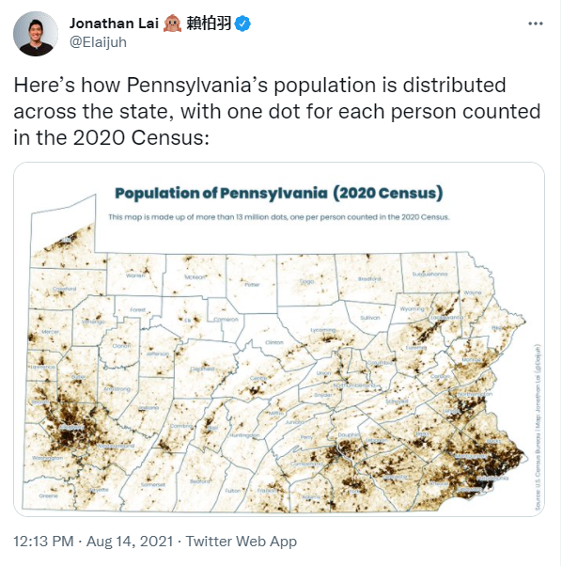

Slide 4
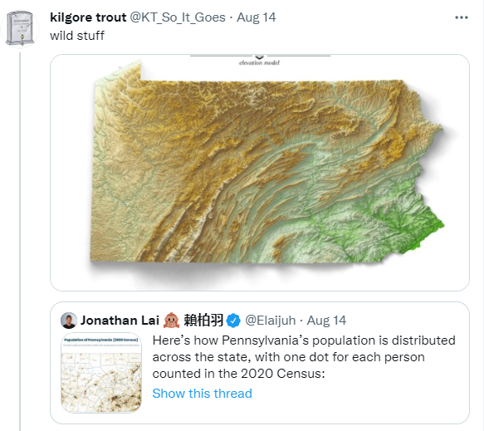

Slide 5
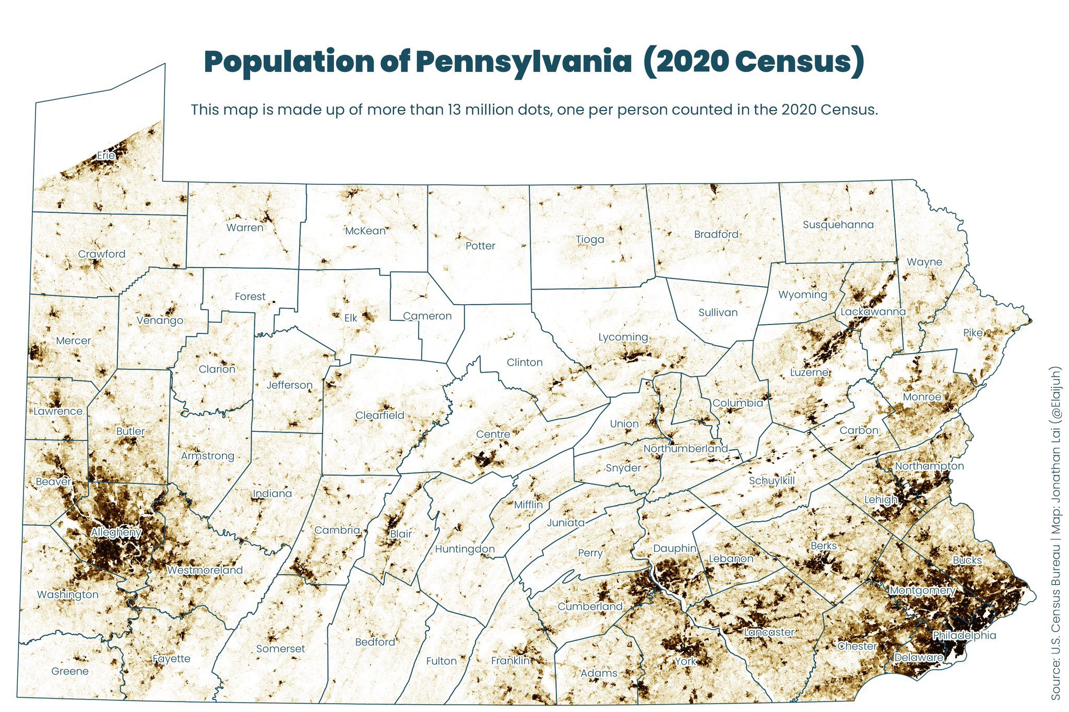

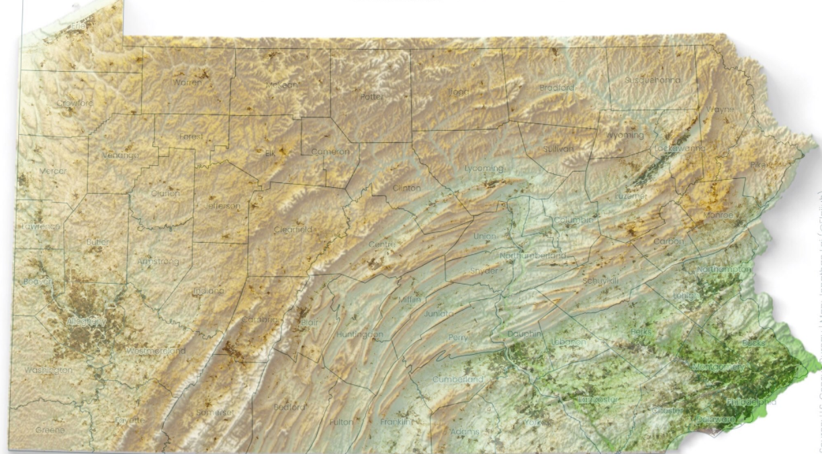
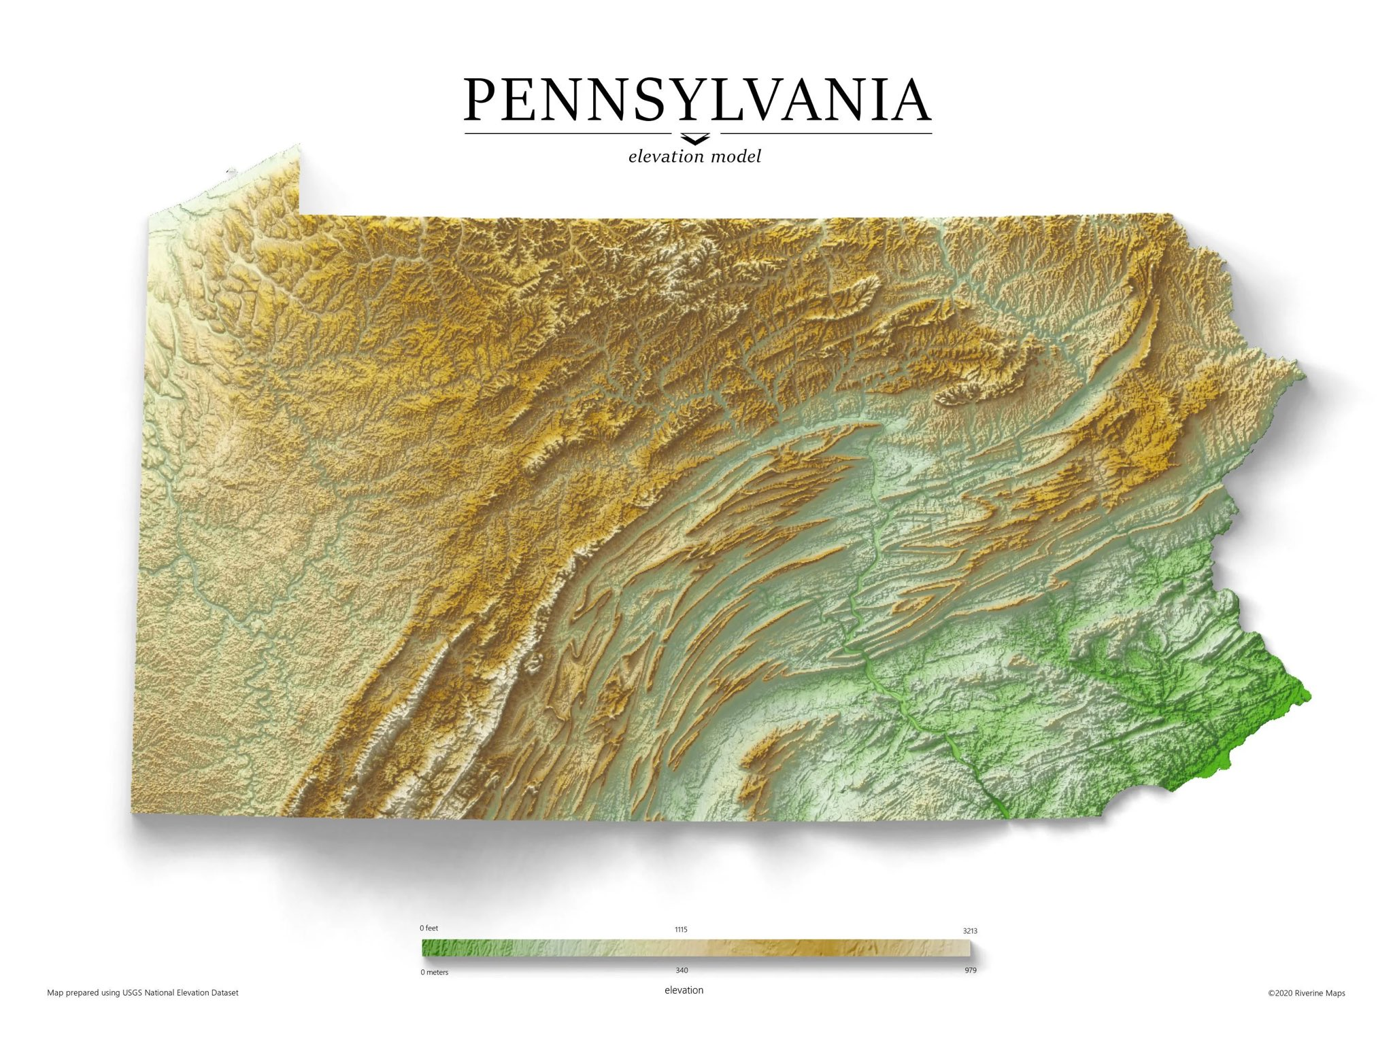

Slide 6
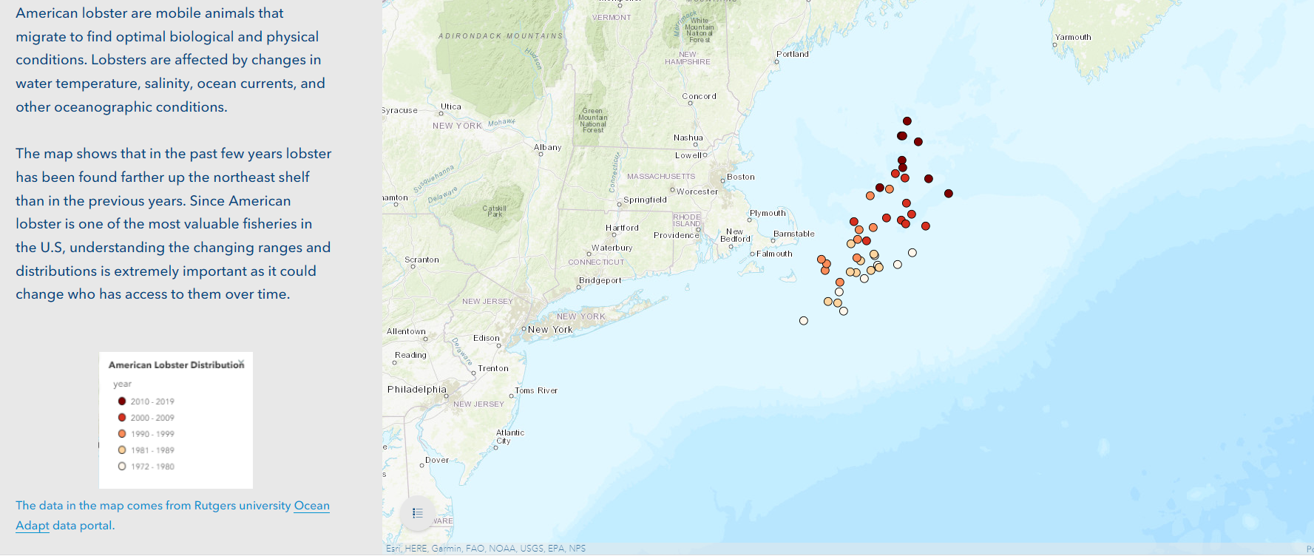
https://storymaps.arcgis.com/stories/b3321ee343c9424eb6557332f81509c6

Slide 7


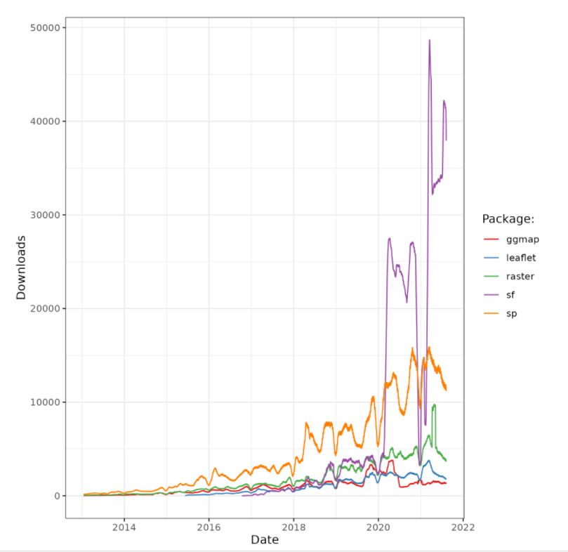
sf
Simple Features
Predecessors: sp, rgdal, rgeos
Can represent all common vector geometry types
Points
Lines
Polygons
Multi versions of the above
Cannot support raster

Slide 8
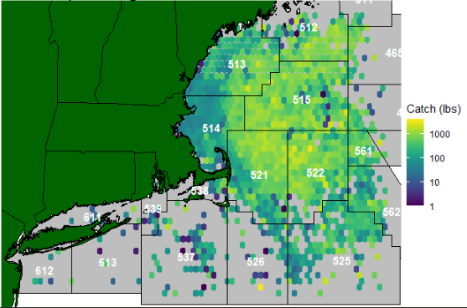
ggplot2
In the tidyverse family
Can do anything
I’ll show you how to use this to build a map by adding layers, sort of like how you would do in GIS

Slide 9
A few things to know about
CRS
Coordinate reference system
Varies depending on what area you are plotting, and by what state or agency you got your data from
NAD84 (4269) is a common one in New England
Shapefiles (.shp)
A common way to store spatial information
Comes in a zip file with a few other file types. I don’t know what those do, but I know you need to have all of them on your machine in order for things to function.

Slide 10

Where can I find some data?
Some packages in R have data built in
marmap – bathymetry data
maps
mapdata
Publicly available geographic data
NOAA Fisheries
https://www.fisheries.noaa.gov/resources/all-science
MassGIS
https://www.mass.gov/info-details/massgis-data-layers
Google “_____ GIS”

Slide 11

Additional resources
Geocomputation in R
https://bookdown.org/robinlovelace/geocompr/
Great place to start
Sean Hardison’s sf workshop
https://github.com/seanhardison1/sf-workshop
sf Cheat sheet:
https://github.com/rstudio/cheatsheets/blob/master/sf.pdf
The R Graph Gallery
https://www.r-graph-gallery.com/index.html
Ggplot2
https://ggplot2-book.org/index.html

